Slide 1
DESIGN (ANTI-)PATTERNS
Coffee Break
Proxy

Slide 2
TYPES
Types
Creational (singleton, builder, lazy init, abstract factory, object pool etc.)
Structural (adapter, bridge, decorator, facade, composite, proxy etc.)
Behavioral (iterator, strategy, template method, visitor, command etc.)
Concurrency (thread pool, double checked locking, monitor object, reactor etc.)

Slide 3
PROXY
GoF Definition
A design pattern that creates a surrogate, or placeholder class.
Concept
Proxy instances accept requests from client objects, pass them to the underlying object and return the results. Proxies can improve efficiency and enhance functionality.
Real-World Example
A credit card is a proxy for a bank account, which is a proxy for a bundle of cash. Both implement the same interface: they can be used for making a payment. A consumer feels great because there’s no need to carry loads of cash around. A shop owner is also happy since the income from a transaction gets added electronically to the shop’s bank account without the risk of losing the deposit or getting robbed on the way to the bank.

Slide 4
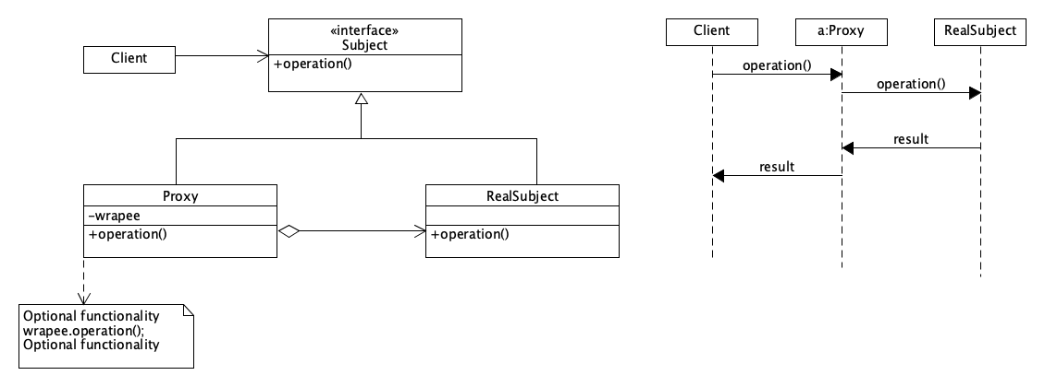
PROXY
UML
Clients calls only Subject::operation and do not care if any Proxies are in way:

Slide 5
PROXY
Checklist to implement proxy:
Identify need of Proxy
Define interface
Real and Proxy classes implements defined interface
Define factory (optional real/proxy)
Wrapper class holds a ref. to real class
Consider Lazy initialization

Slide 6
PROXY
Types of proxy:
Virtual
  real object is only created when a client first requests/accesses the object
Remote
  provides a local object that references a subject object in another location, generally via a network connection
Protective
  checks that the caller has the access permissions required prior to forwarding the request
Caching
  when you need to cache results of client requests and manage the life cycle of this cache, especially if results are quite large.
Smart
  interposes additional actions when an object is accessed : counting ref., load persistent obj., locking obj.

Slide 7
PROXY
Demo

Slide 8
PROXY
Pros
You can control the object without clients knowing about it.
You can manage the lifecycle of the object when clients don’t care about it.
The proxy works even if the object isn’t ready or is not available.
Open/Closed Principle. You can introduce new proxies without changing the service or clients.
Cons
The code may become more complicated since you need to introduce a lot of new classes.
The response from the service might get delayed.

Slide 9
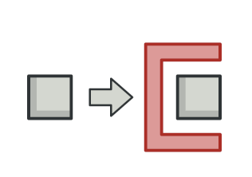
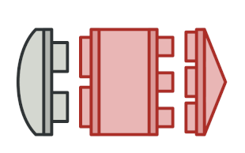
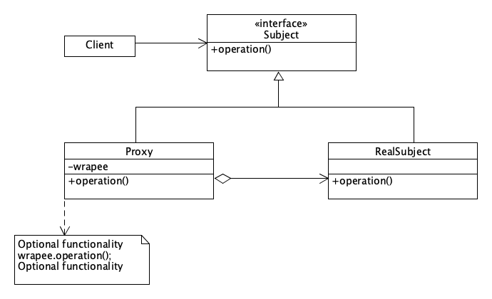
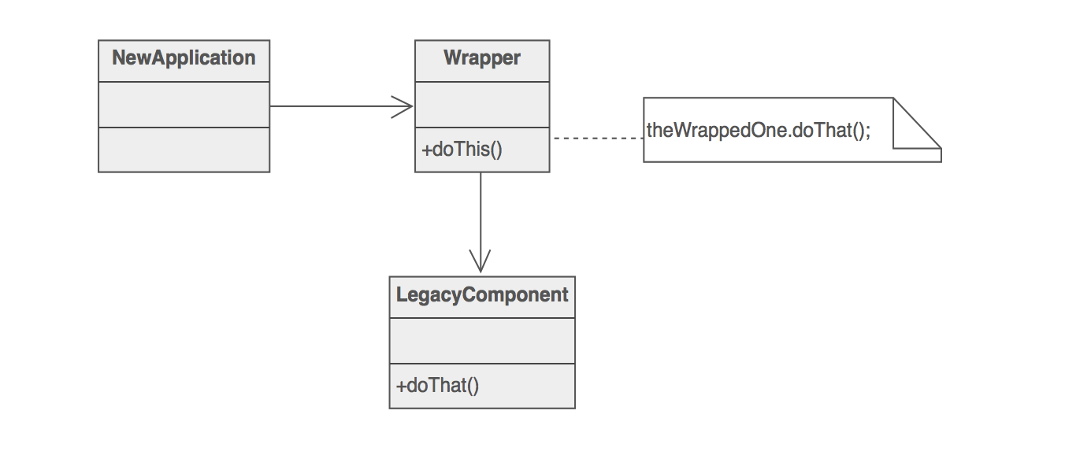
PROXY
Relations with Other Patterns - Adapter
provides a different interface to the wrapped object

Slide 10
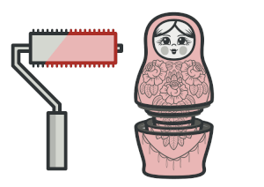
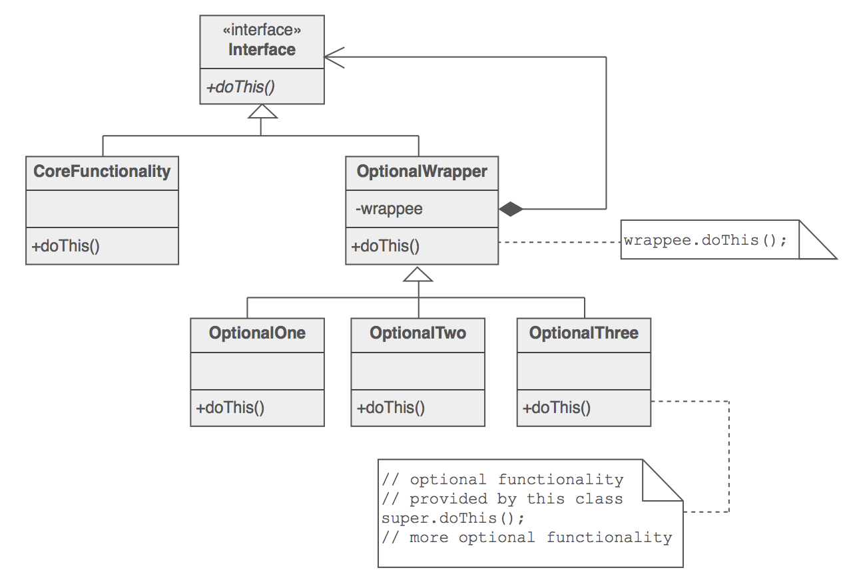
PROXY
Relations with Other Patterns – Decorator
same interface method
Decorator - enhanced interface

Slide 11
PROXY
Where is Proxy used :
Java API: java.rmi.*;
Java EE – business delegate
Spring framework – AOP, remoting
JPA - Hibernate

Slide 12
PROXY
Q&A

Slide 13
PROXY
Sources
https://learning.oreilly.com/videos/design-patterns-in/9781771374040/9781771374040-video214993
https://www.tutorialspoint.com/design_pattern/proxy_pattern.htm
https://www.geeksforgeeks.org/proxy-design-pattern/
https://sourcemaking.com/design_patterns/proxy
https://refactoring.guru/design-patterns/proxy
https://learning.oreilly.com/library/view/design-patterns-in/9780321630483/ch11.html
https://learning.oreilly.com/library/view/javatm-design-patterns/0201485397/ch15.html
http://www.blackwasp.co.uk/Proxy.aspx

